Slide 1
AI-Powered Health Monitoring System

Slide 2
AI-Powered Health Monitoring System
Author: June Oyugi
Course: AI for Software Engineering
Date: November 27, 2025

Slide 3
Abstract / Overview
AI-powered system monitoring heart rate, SpO2, and activity.
Detects anomalies using IsolationForest.
Provides real-time actionable recommendations.

Slide 4
Problem Statement
Continuous health monitoring is essential.
Manual observation is impractical.
Need an automated AI system.

Slide 5
Objectives
Monitor vital signs in real-time.
Detect anomalies automatically.
Provide recommendations via user interface.

Slide 6
System Architecture Diagram
Frontend (HTML/JS) → Backend (FastAPI) → AI Model (IsolationForest)
Data flow arrows showing telemetry and prediction.

Slide 7
Data Simulation
Simulated heart rate, SpO2, activity level.
Code snippet showing data generation.
Placeholder for chart example.

Slide 8
AI Model
Algorithm: IsolationForest.
Detects anomalies in telemetry data.
Shows training pipeline and model saving.

Slide 9
Backend (FastAPI)
Serves static frontend.
Exposes `/api/stream`, `/api/status`, `/api/train`, `/api/predict`.
Handles requests and sends model results.

Slide 10
API Endpoints Overview
/api/stream`: Live telemetry.
/api/status`: Backend & model status.
/api/train`: Retrain model.
/api/predict`: Predict anomalies.

Slide 11
Frontend / Live Dashboard
Displays live telemetry charts.
Shows anomaly alerts.
Polls backend endpoints.

Slide 12
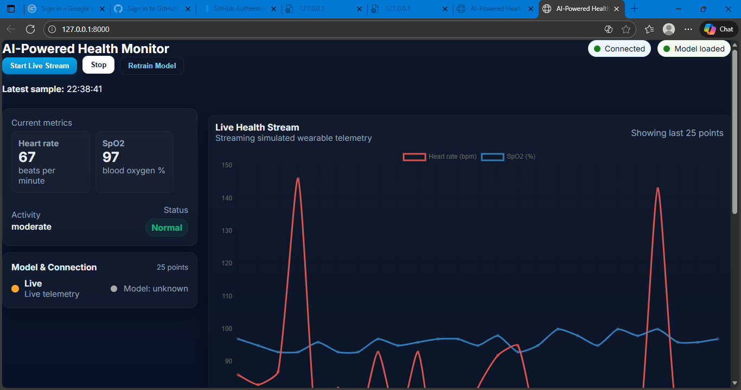
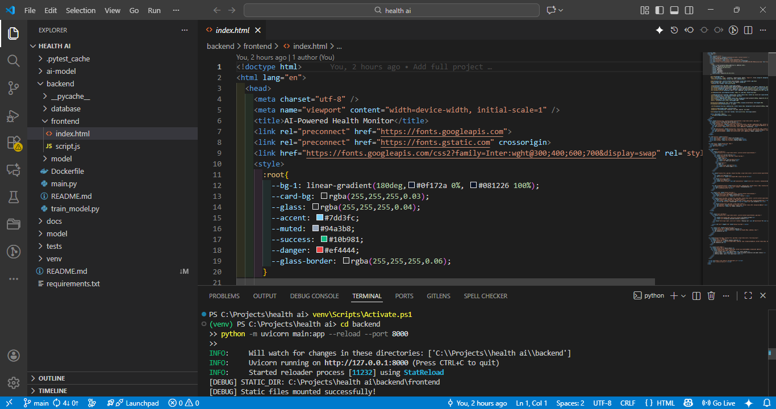
Telemetry Charts Example
Placeholder screenshot of live chart (heart rate & SpO2).
Code snippet showing dynamic update.

Slide 13
Anomaly Detection Alerts
Cards pop up when anomalies detected.
Color-coded indicators.
Example snippet of status display.

Slide 14
Testing & Validation
Unit tests for backend & model.
Integration tests for end-to-end flow.
User simulation to trigger anomalies.

Slide 15
Deployment
Local: Uvicorn server.
Optional cloud deployment (Docker + Azure/AWS).
REST API endpoints available for clients.

Slide 16
Challenges & Solutions
OneDrive file locks → moved project folder.
Data privacy → used simulated data.
Model accuracy → fine-tuned parameters.
Scalability → backend handles multiple users.

Slide 17
Conclusion
Fully functional AI-powered health monitoring prototype.
Real-time anomaly detection & recommendations.
Future work: real wearable integration, mobile app frontend.

Slide 18
References
scikit-learn
FastAPI
Python
PhysioNet Database

